Slide 1
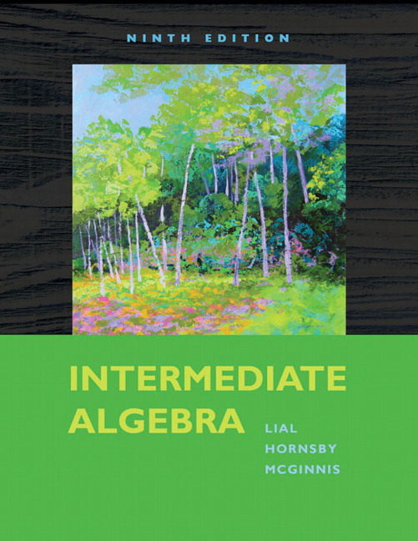

Slide 2
Chapter 5
Systems of Linear Equations

Slide 3
5.4
Solving Systems of Linear Equations
by Matrix Methods

Slide 4
5.4 Solving Systems of Linear Equations by Matrix Methods
Objectives
Define a matrix.
Write the augmented matrix for a system.
Use row operations to solve a system with two equations.
Use row operations to solve a system with three equations.
Use row operations to solve special systems.
Copyright © 2010 Pearson Education, Inc. All rights reserved.
Sec 5.4 - <number>

Slide 5
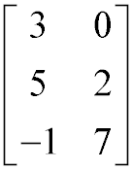
5.4 Solving Systems of Linear Equations by Matrix Methods
Define a matrix.
An ordered array of numbers such as
Columns
Elements
Row 3 is –1 7.
Column 2 is 0 2 7.
Rows
Matrix
is called a matrix. The numbers are called elements of the matrix. Rows are read horizontally, and columns are read vertically.
Copyright © 2010 Pearson Education, Inc. All rights reserved.
Sec 5.4 - <number>

Slide 6
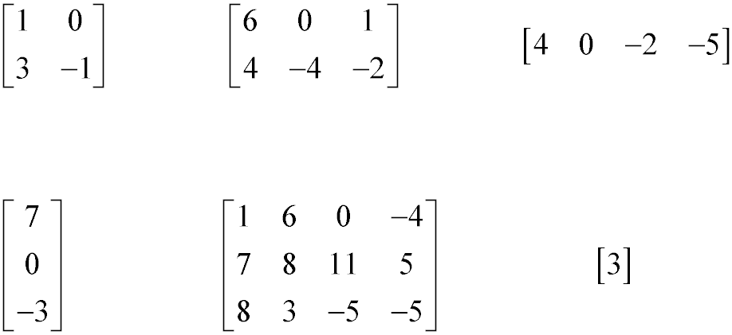
5.4 Solving Systems of Linear Equations by Matrix Methods
Define a matrix.
Matrices are named according to the number of rows and columns they contain.
2 × 2
2 × 3
1 × 4
1 × 1
3 × 1
3 × 4
Copyright © 2010 Pearson Education, Inc. All rights reserved.
Sec 5.4 - <number>

Slide 7
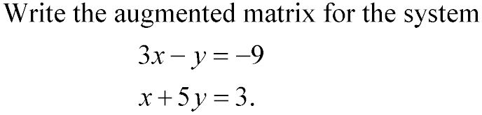
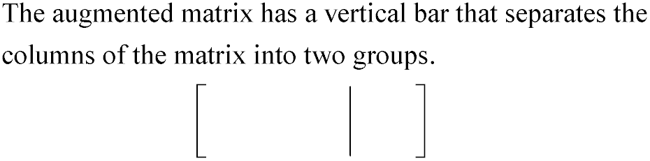
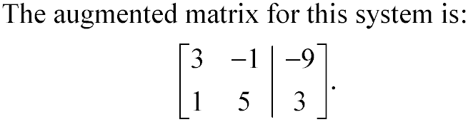
5.4 Solving Systems of Linear Equations by Matrix Methods
Write the augmented matrix for a system.
Constants
Coefficients
Copyright © 2010 Pearson Education, Inc. All rights reserved.
Sec 5.4 - <number>

Slide 8
5.4 Solving Systems of Linear Equations by Matrix Methods
Matrix Row Operations
When solving systems of equations, we know that exchanging the position of two equations in the system does not change the system.
Also, multiplying any equation in the system by a nonzero number does not change the system.
Because augmented matrices are just a shorthand way of writing systems of equations, comparable changes to the augmented matrix of a system produces new matrices that correspond to systems having the same solution as the original system.
Copyright © 2010 Pearson Education, Inc. All rights reserved.
Sec 5.4 - <number>

Slide 9
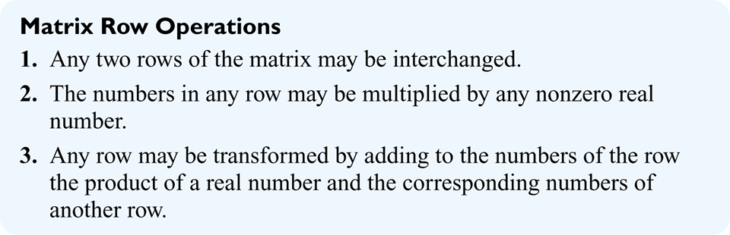
5.4 Solving Systems of Linear Equations by Matrix Methods
Matrix Row Operations
The following row operations produce new matrices that lead to systems having the same solution as the original system.
Copyright © 2010 Pearson Education, Inc. All rights reserved.
Sec 5.4 - <number>

Slide 10
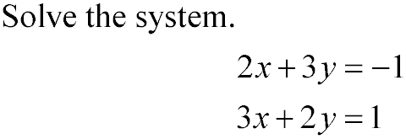
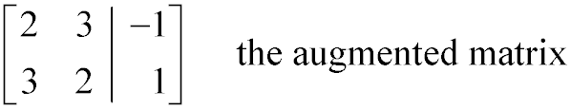
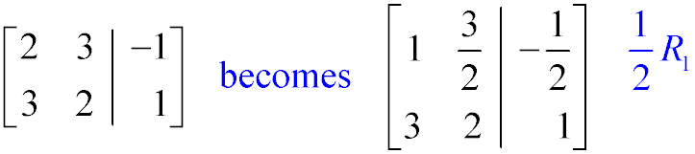
5.4 Solving Systems of Linear Equations by Matrix Methods
Using Row Operations to Solve a System with Two Variables
Solution:
Copyright © 2010 Pearson Education, Inc. All rights reserved.
Sec 5.4 - <number>

Slide 11
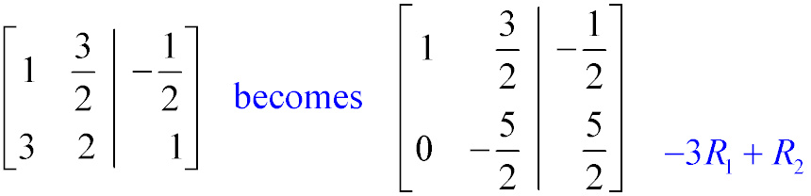
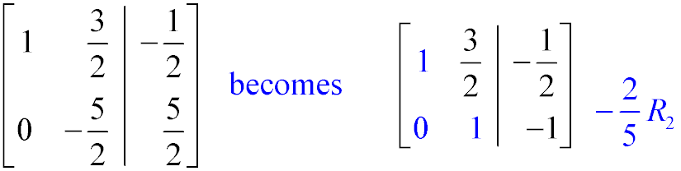
5.4 Solving Systems of Linear Equations by Matrix Methods
Using Row Operations to Solve a System with two Variables
Solution:
row echelon form
Copyright © 2010 Pearson Education, Inc. All rights reserved.
Sec 5.4 - <number>

Slide 12
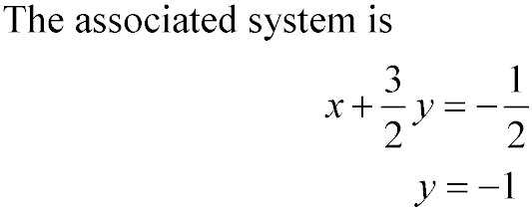
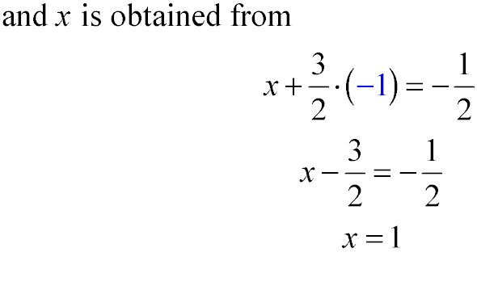
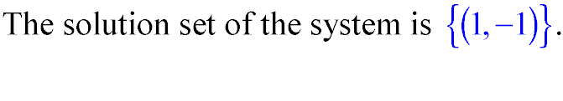
5.4 Solving Systems of Linear Equations by Matrix Methods
Using Row Operations to Solve a System with two Variables
Solution:
You should always check the solution by substitution in the original system.
Copyright © 2010 Pearson Education, Inc. All rights reserved.
Sec 5.4 - <number>

Slide 13
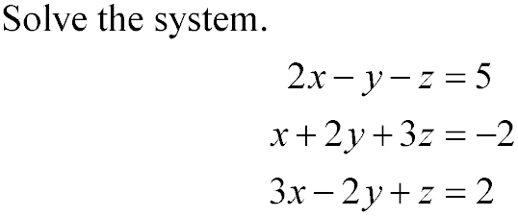
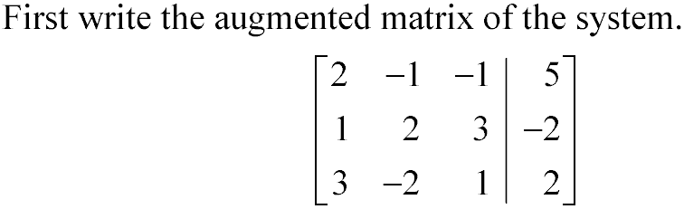
5.4 Solving Systems of Linear Equations by Matrix Methods
Using Row Operations to Solve a System with Three Variables
Solution:
Copyright © 2010 Pearson Education, Inc. All rights reserved.
Sec 5.4 - <number>

Slide 14
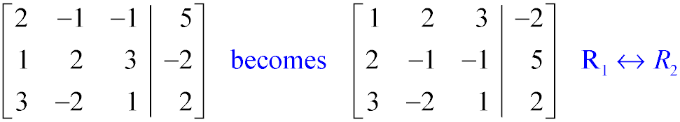
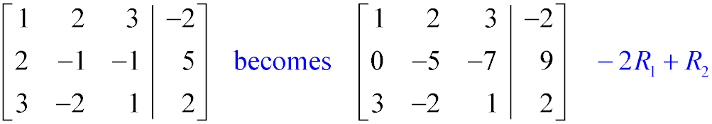
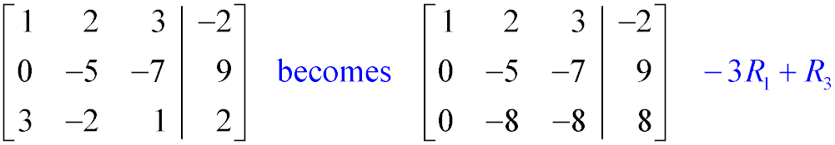
5.4 Solving Systems of Linear Equations by Matrix Methods
Using Row Operations to Solve a System with Three Variables
Solution:
Copyright © 2010 Pearson Education, Inc. All rights reserved.
Sec 5.4 - <number>

Slide 15
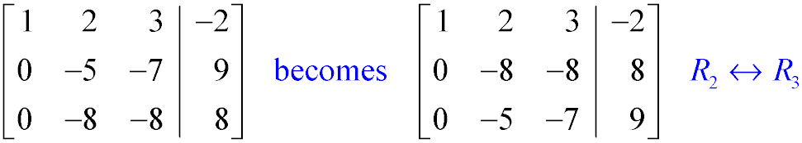
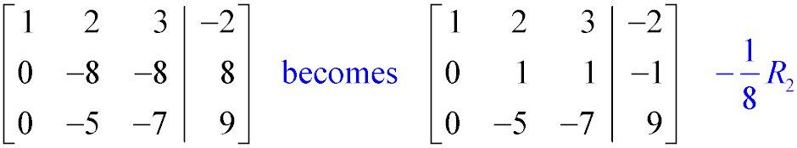
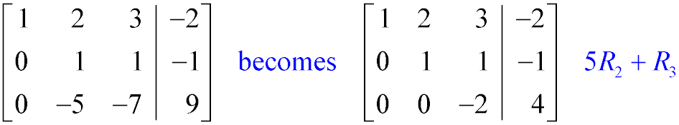
5.4 Solving Systems of Linear Equations by Matrix Methods
Using Row Operations to Solve a System with Three Variables
Solution:
Copyright © 2010 Pearson Education, Inc. All rights reserved.
Sec 5.4 - <number>

Slide 16
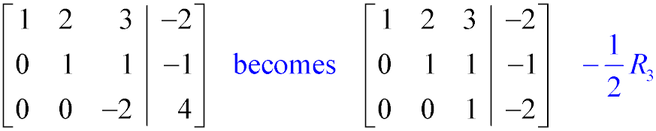
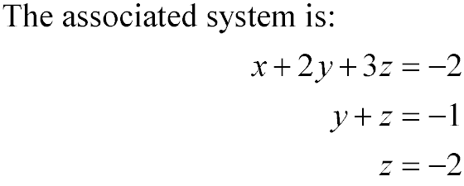
5.4 Solving Systems of Linear Equations by Matrix Methods
Using Row Operations to Solve a System with Three Variables
Solution:
Now we already have a value for z.
Copyright © 2010 Pearson Education, Inc. All rights reserved.
Sec 5.4 - <number>

Slide 17
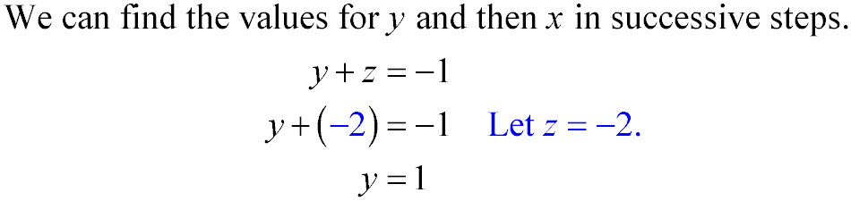
5.4 Solving Systems of Linear Equations by Matrix Methods
Using Row Operations to Solve a System with Three Variables
Solution:
Copyright © 2010 Pearson Education, Inc. All rights reserved.
Sec 5.4 - <number>

Slide 18
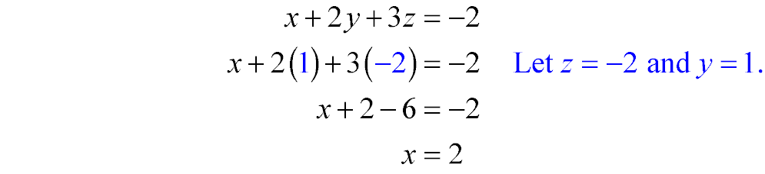
5.4 Solving Systems of Linear Equations by Matrix Methods
Using Row Operations to Solve a System with Three Variables
Solution:
You should always check the solution by substitution in the original system.
Copyright © 2010 Pearson Education, Inc. All rights reserved.
Sec 5.4 - <number>

Slide 19
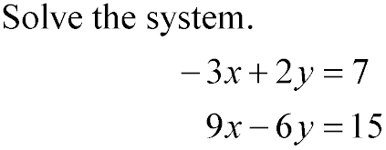
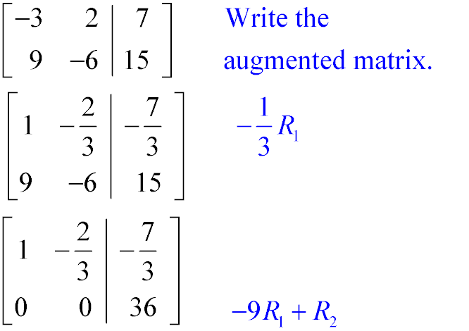
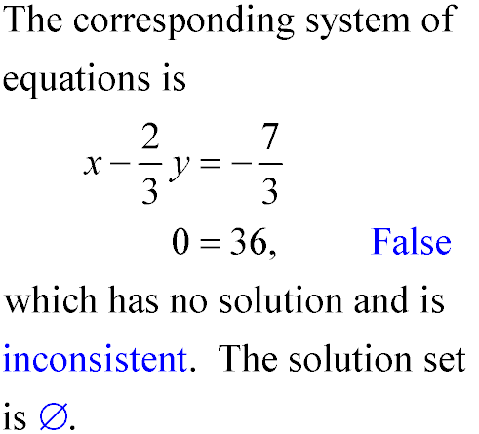
5.4 Solving Systems of Linear Equations by Matrix Methods
Recognizing Inconsistent or Dependent Systems
Copyright © 2010 Pearson Education, Inc. All rights reserved.
Sec 5.4 - <number>

Slide 20
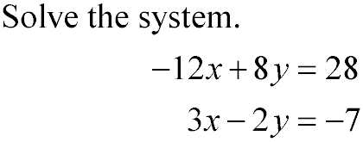
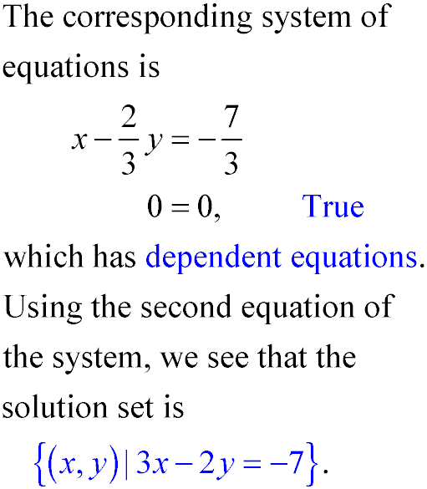
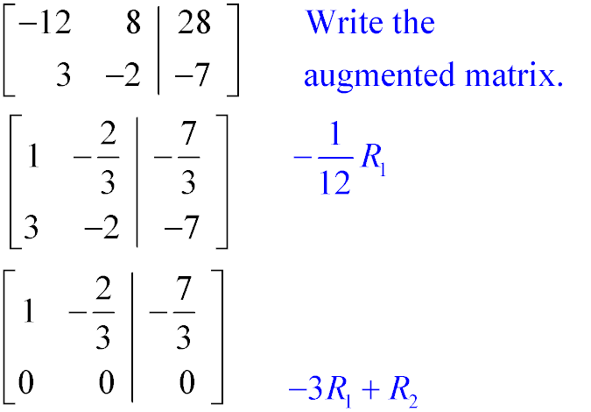
5.4 Solving Systems of Linear Equations by Matrix Methods
Recognizing Inconsistent or Dependent Systems
Copyright © 2010 Pearson Education, Inc. All rights reserved.
Sec 5.4 - <number>

